Slide 1


Car Buying Predictions based on Available data
Group Members
Miss.Hardika Lalwani(20202003)
Mr. Jainam Zaveri (20202007)
Mr. Jayesh Jain(19102021
Course: Machine Learning
Month-Year: July-2021
Guide- Prof Jaya Gupta

Slide 2
CONTENTS
Introduction
Statement of Problem
Dataset Used
Output
Advantages of using logistic regression
Applications
Conclusion

Slide 3
Introduction
The Project was developed to identify number of car buyers based on data.
Logistic Regression in machine learning was used in this project.
Pre-processing of data is done and then the prediction was done using logistic regression.
Our model predicts 89 correct and 11 wrong decisions which shows 89% accuracy based on the datasets

Slide 4
Statement Of Problem
Suppose a company is going to launch a new campaign for their new brand of car and want to know which category of people are likely to buy their brand new car so they can have the ads that target those peoples.

Slide 5
Dataset Used
The dataset contains entries which contains the userId, gender, age, estimated salary and the purchased history.
The matrix of features taken into account are age and estimated salary which are going to predict if the user is going to buy new car or not

Slide 6
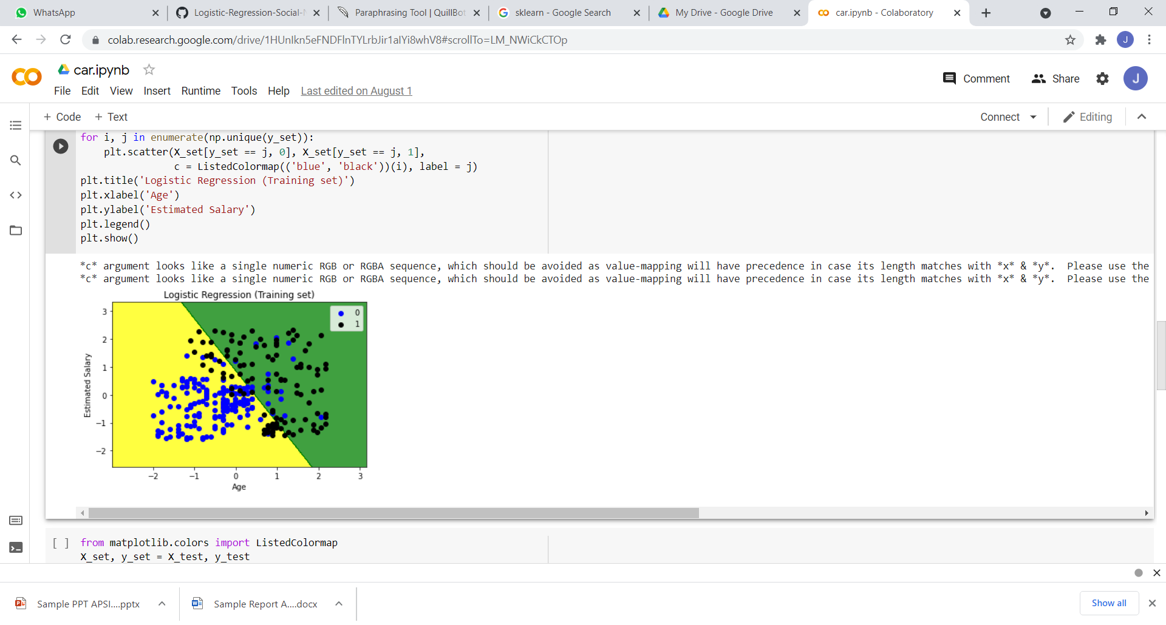
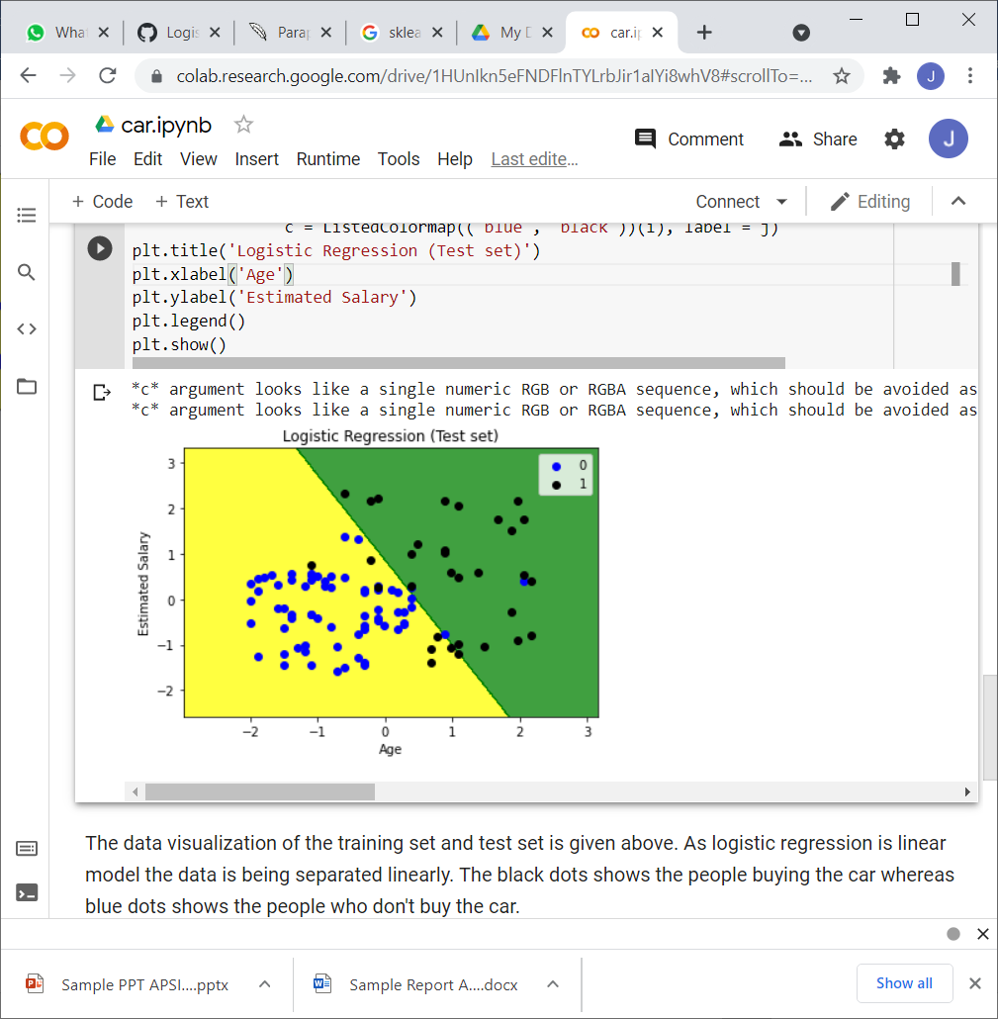
Output
The black dots show the people buying the car whereas blue dots shows the people who don't buy the car.

Slide 7
Advantages of using logistic regression
Logistic regression is easier to implement, interpret, and very efficient to train.
It is very fast at classifying unknown records
Good accuracy for many simple data sets and it performs well when the dataset is linearly separable.
It can interpret model coefficients as indicators of feature importance

Slide 8
Applications
Sales of Particular Products.
Identify the buyer’s ratio.
Marketing effects on Products.

Slide 9
Conclusion
Thus, we have developed a project on Car Buying Prediction based on the available dataset by using logistic regression in machine learning under this internship provided by Apsit Skills.

Slide 10
THANK YOU!

